Slide 1
Predicting Gun Violence in the U.S
Josh, Jake, Sebastian, Jessica

Slide 2
Agenda
01
Problem overview
06
Final Results
02
Dataset overview
07
Conclusion
03
Candidate algorithms
08
Streamlit Demo
04
Performance comparison
05
Tuning Steps

Slide 3
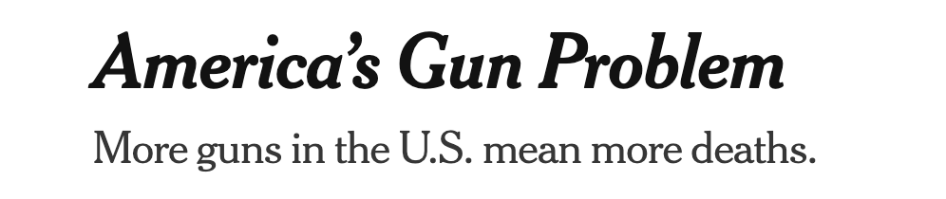
Problem Overview
Gun violence is one of the leading causes of preventable death in the United States.

Slide 4
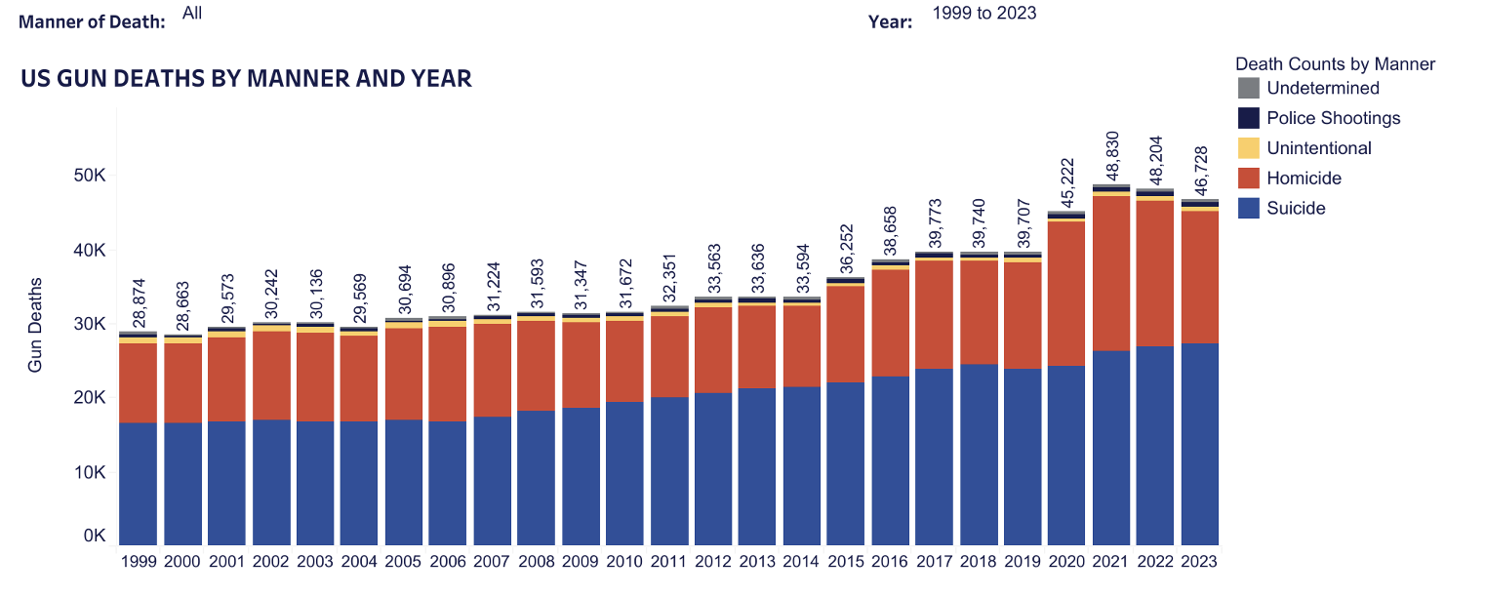
A Growing Trend in this Country

Slide 5
Problem Overview
Public agencies and communities often struggle to identify which counties are most at risk before violence escalates.
Without early identification:
• Resources are allocated reactively instead of proactively
• High-risk communities may not receive intervention in time
• Policymakers rely on incomplete or anecdotal information

Slide 6
Predictive Question
Given socioeconomic,demographic, and social vulnerability features for a U.S. county, can we accurately predict whether that county has a "high level" of gun violence?
Secondary Predictive Question
What are the top 5–8 features that have the most influence on whether a county is classified as high gun violence?

Slide 7
Data Source
3 Data Sources
“Underlying Cause of Death, 2018-2024, Single Race” from CDC
ID for counties, dates, deaths, population, crude rate (event/population)
SVI
Unemployment, minority %, Disabled %, etc.
Government census (ACS Data)
Median household income, population below poverty level
Data Quality
13,328 rows 32 columns
No missing values
No duplicates
Target column = Violence Level
Taking median crude rate and labeling higher medians as “high” and lower as “low”
We frame this as a binary classification problem: each county-year observation is labeled high or low gun violence, and four models are trained to predict that label.

Slide 8
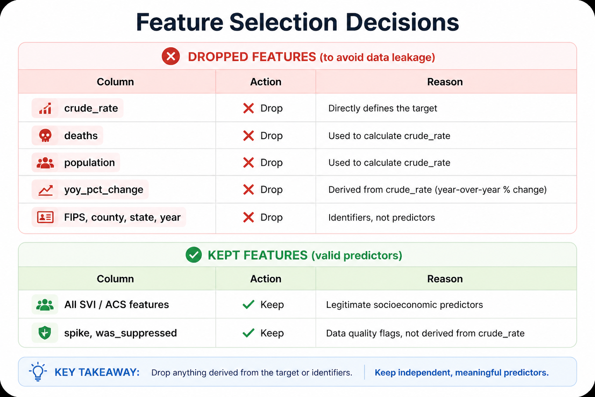
Feature Selection and Leakage
Final = 26 Columns

Slide 9
Candidate Algorithms
Logistic Regression
Interpretable coefficients, useful for predicting categorical outcomes
Handles multicollinearity
Random Forest
Handles many predictor variables
Strong classification model
Handle nonlinearity
Neural Network
Captures complex feature interactions
XGBClassifer
Works well with tabular data with many numeric variables
Capture nonlinear relationships
Notes:
Justify your choice of candidate algorithms and your choice of performance targets to compare the candidate models

Slide 10
Performance Targets
Accuracy → Overall Correctness
Precision → how many predicted high-violence counties are actually high
Recall → how many actual high-violence counties we correctly identify
F1 Score→ Balance between precision and recall
ROC AUC → Overall model discrimination ability
Confusion Matrix → breakdown of predictions

Slide 11
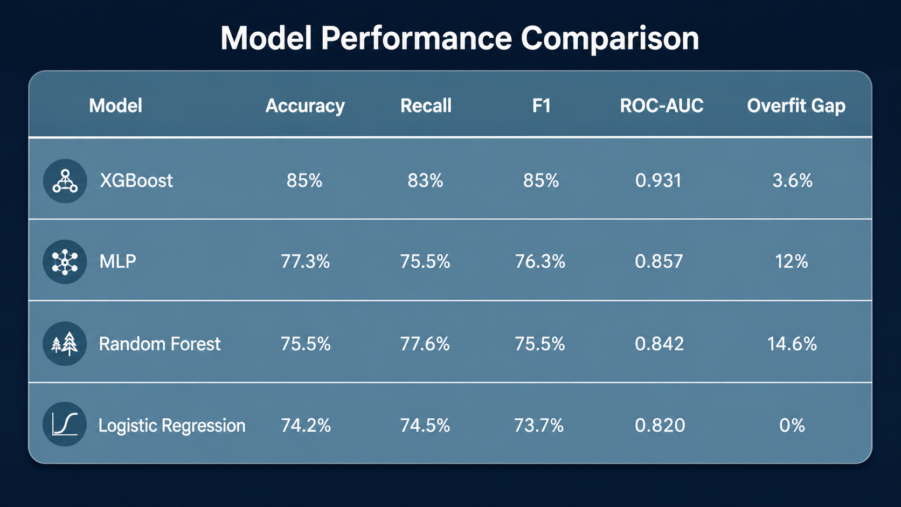

Slide 12
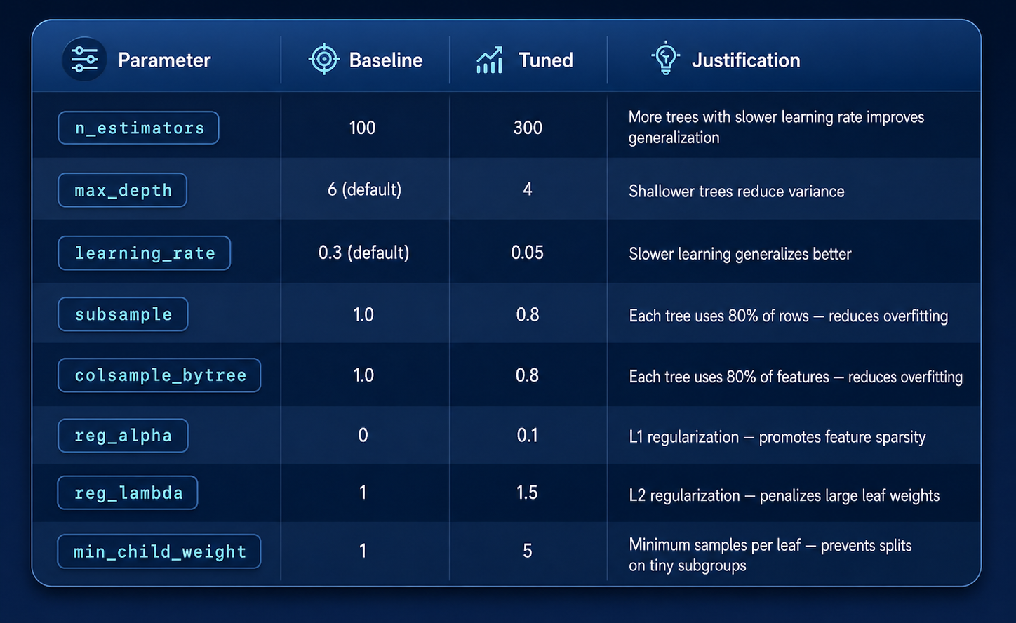
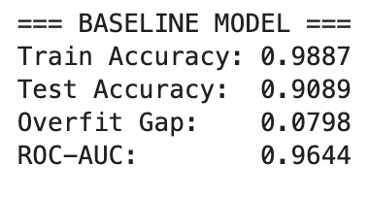
XGBClassifer Tuning
Overfitting due to leakage

Slide 13
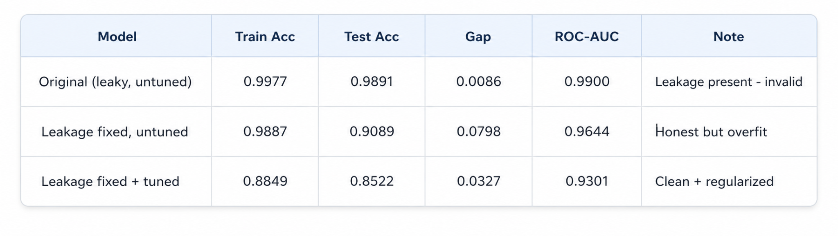
XGBClassifier: Performance Improvements

Slide 14
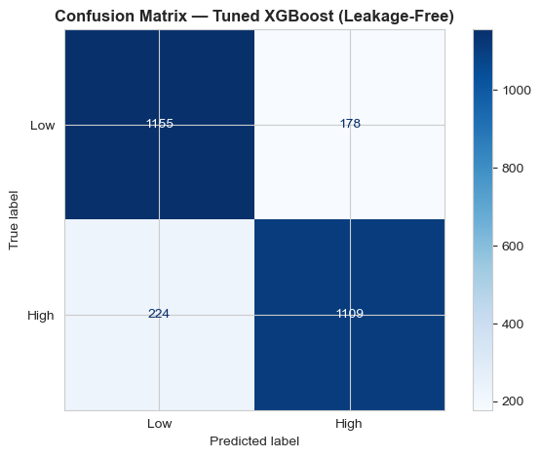
Confusion Matrix

Slide 15
Final results
Yes, given socioeconomic,demographic, and social vulnerability features for a U.S. county, we can somewhat accurately predict whether that county has a "high level" of gun violence?
Limitations:
Specific legislation or executive orders cannot be measured
The median-split binary label discards variation within high/low groups; a regression approach could be more informative
Stratified random split — a temporal split (train 2019–2021, test 2022–2023) would better simulate real deployment
County-level predictions mask within-county neighborhood variation

Slide 16
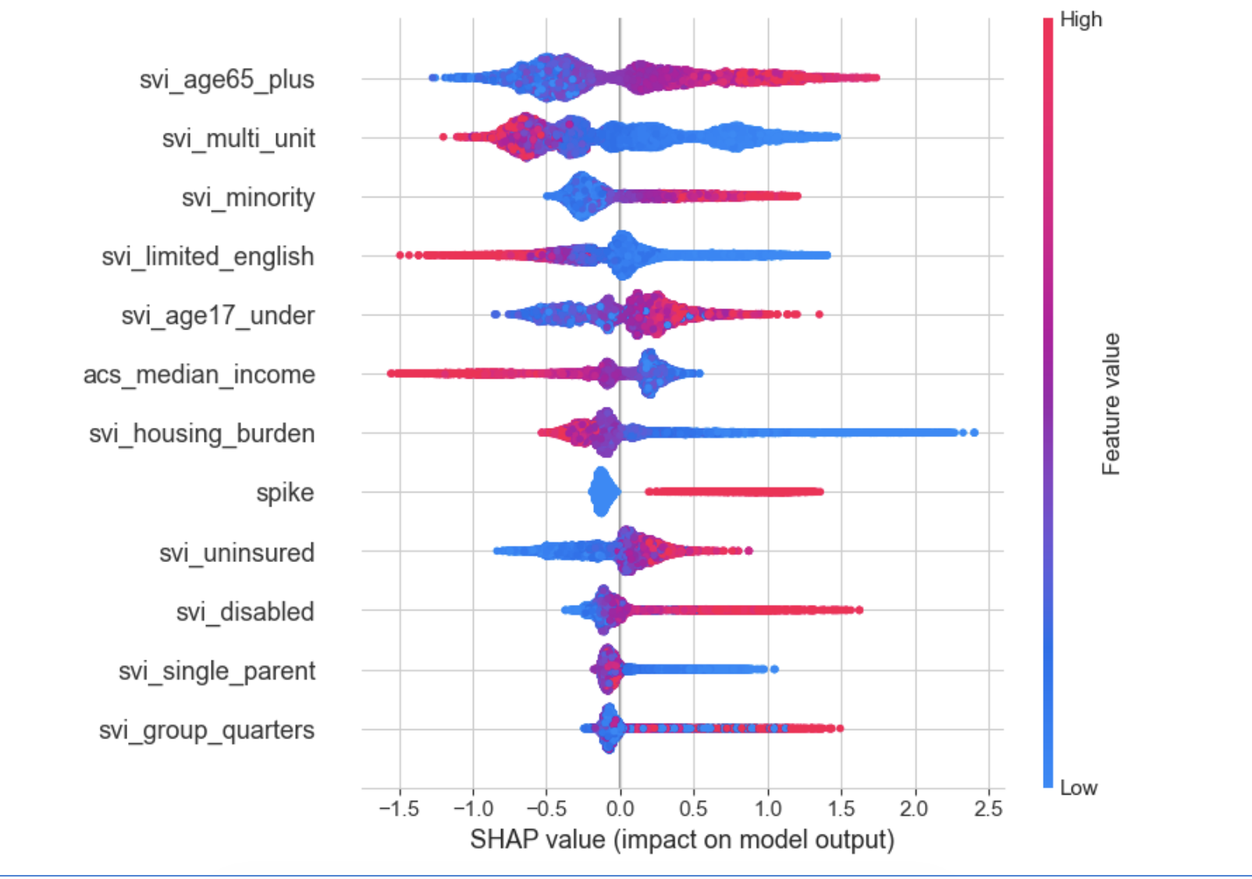
SHAP Report
Top Features Predicting High Gun Violence
svi_multi_unit — 0.1931
acs_median_income — 0.0774
svi_disabled — 0.0457
svi_housing_burden — 0.0453
spike — 0.0448
svi_age65_plus — 0.0424
svi_unemp_rate — 0.0416
acs_unemp_rate — 0.0414

Slide 17
Recommendations
Target low income and high unemployment counties
Education and career support
Housing and health stability
Helping children attend school
Initiatives to support classrooms
Career or higher education counseling in high school
Expand job training and employment programs
Support affordable housing
Eviction prevention
Neighborhood investment
Increase access to trauma care and insurance enrollment
Access to mental health resources

Slide 18
Key Takeaways
Based on the top 8 features urban socioeconomic deprivation is the dominant signal.
Future improvements
Temporal train/test split to simulate true deployment scenario
Multi-class outcome: low / medium / high for more actionable risk tiers
Add additional features: gun law index, social cohesion measures

Slide 19
Streamlit Demo
https://gun-violence-early-warning-system.streamlit.app/

